Slide 1

Auction Website – A MERN Stack Project
Mentor – Dr. Sakshi Shringi & Dr. Hemlata Parmar
Nupur Saboo – 209301658
Bhavya Aggarwal – 209301312

Slide 2


Why MERN Stack?
MongoDB
 | MySQL | MongoDB
Written in | C++, C | C++, C and JavaScript
Type | RDBMS | Document-Oriented
Main points | - Table - Row - Column | - Collection - Document - Field
Schemas | Strict | Dynamic
Scaling | Vertically | Horizontally
Key features | - Full text searching and Indexing - Triggers - SubSELECTs - Query caching - SSL support | - Auto-sharding - Native replication - Embedded data model support - Comprehensive secondary indexes - Rich query language
NoSQL Database
Document-oriented
Mongoose API

Slide 3
ER Diagram:

Slide 4
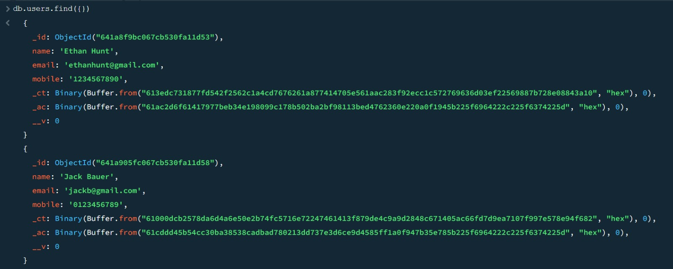
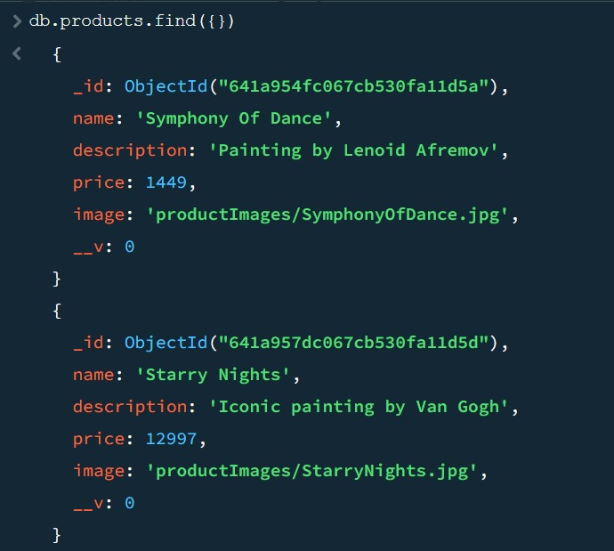
A sneak-peek into our Database:
User Schema:
Product Schema:

Slide 5
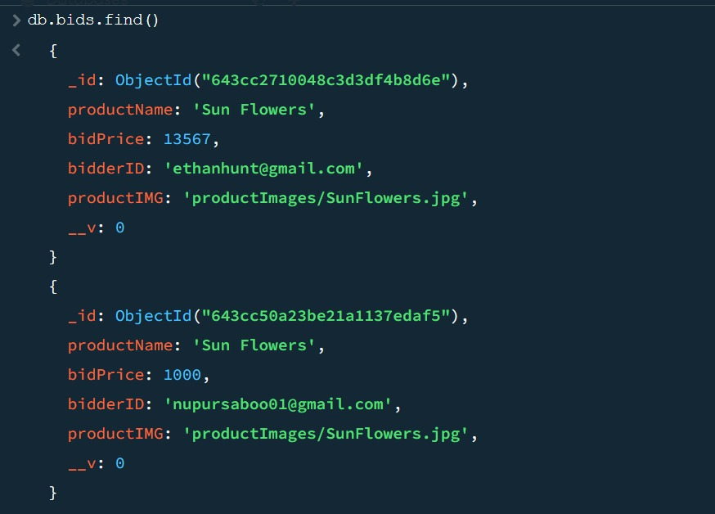
Bid Schema:

Slide 6

Flexible Node.js framework that provides robust set of features web and mobile application
Routing with URL binding
Static files
Promise (async and await)
Body-parser, Cookie-parser
Express.js

Slide 7

 | React JS
Author | Facebook
Type | Open Source JS library
App Architecture | Node
Data Binding | Uni-Directional
DOM | Virtual DOM
Front-end library developed by Facebook. It handles the view layer for web and mobile apps.
React is all about components.
React-router to handle the front-end routing.
React.js

Slide 8
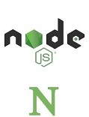
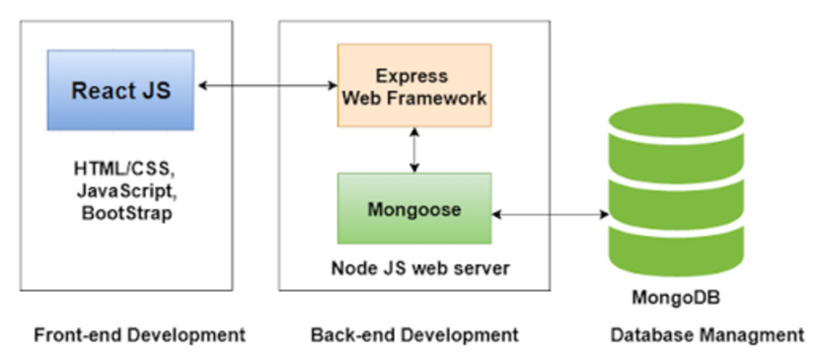
Node.js
Powerful JavaScript based platform.
Single threaded but highly scalable.
Call-backs and event-driven.
Node Package Module(NPM)

Slide 9
Timeline
Mid-Term Presentation
23-MAR
Creation of Bids Schema
30-MAR
Rendering My Bids page using React.js
6-APR
Integrating the newly created Frontend with Backend
13-APR
Committed the final version on GitHub.
19-APR
End-Term Presentation
20-APR

Slide 10
Our Project

Slide 13
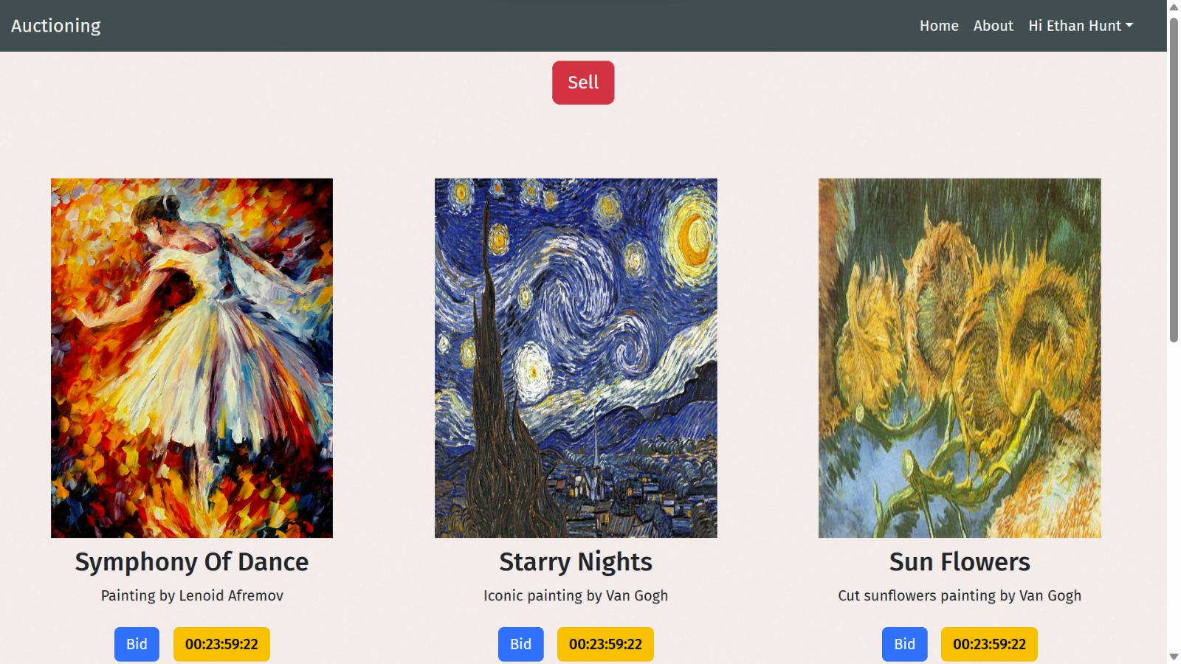

Slide 14
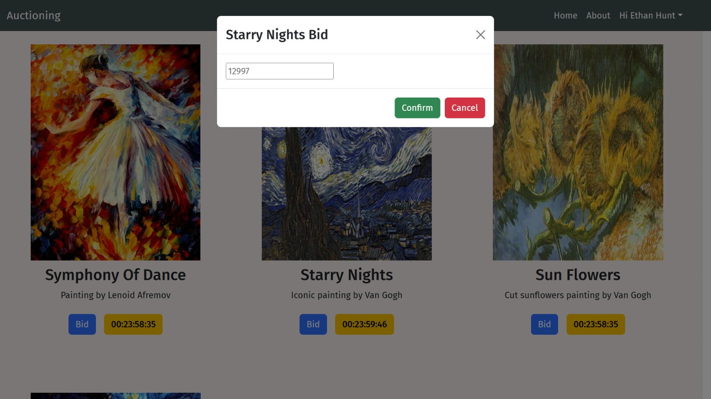

Slide 15
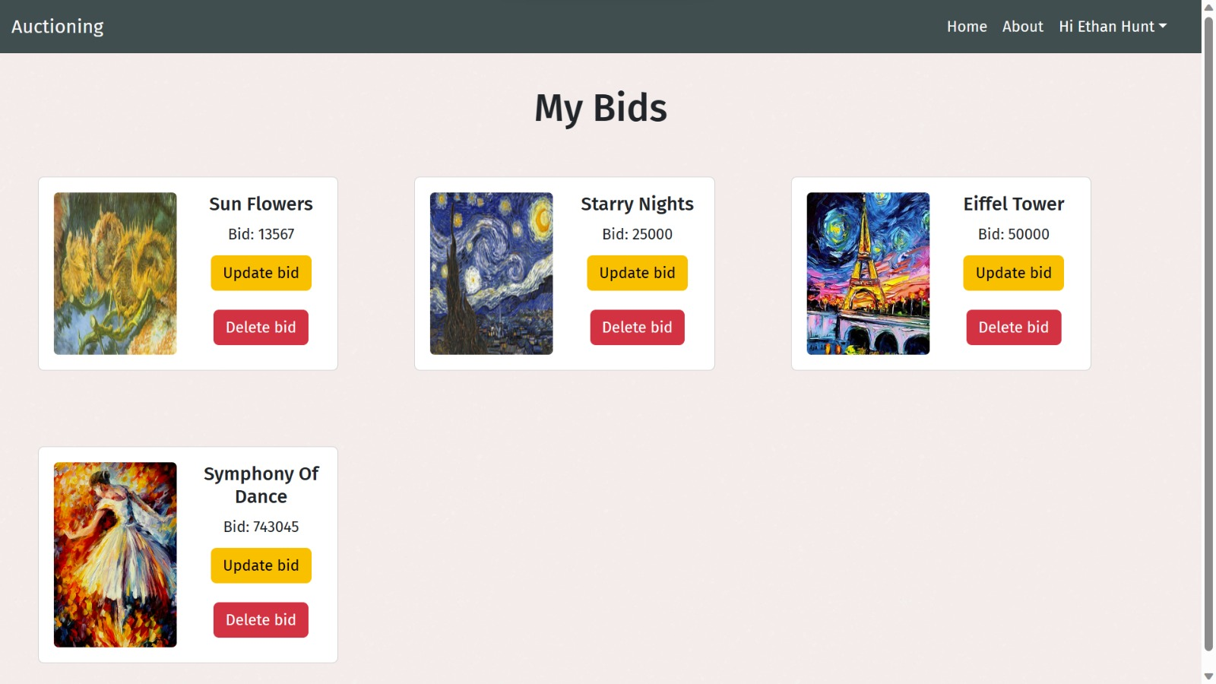

Slide 16
Things Learned During Development
A detailed plan is essential to efficient development
Connecting React to Node/Express to create full stack app
Bootstrap Modals
Commit regularly and don't be afraid to roll back
Patience while chasing a particularly elusive bug

Slide 17
Planned Features
Higher Authentication and security- encryption and google signup and sign-in
Project Deployment
Payments Portal API
Email Communications

